Slide 1


Slide 2

“
“Data analytics is the future, and the future is NOW!
Every mouse click, keyboard button press, swipe or tap is
used to shape business decisions. Everything is about data
these days.
Data is information, and information is power.”
2

Slide 3

Introduction
Ourꢀprojectꢀdealsꢀwithꢀtheꢀdataꢀanalysisꢀofꢀairꢀtrafficꢀlandingꢀstatistics.
HereꢀweꢀcollectꢀlandingꢀstatisticsꢀdataꢀofꢀsanꢀFranciscoꢀairportꢀoverꢀaꢀtimeꢀperiodꢀofꢀ
Julyꢀ2015ꢀtoꢀfeburaryꢀ2016ꢀthatꢀalsoꢀincludeꢀoperatingꢀairlines,ꢀpublishedꢀairlines,ꢀGEOꢀ
region,ꢀaircraftꢀbodyꢀtype,ꢀAircraftꢀversion,ꢀlandingꢀcountꢀandꢀtotalꢀweight.
DataꢀsetꢀURLꢀ:ꢀhttps://data.world/sanfrancisco/fpux-q53t
3

Slide 4

San Francisco
Airport
4

Slide 5

DataꢀAnalysis
DATAꢀCOLLECTION
DATAꢀPRE-PROCESSINGꢀ&
CLEANING
ꢀConversionꢀofꢀrawꢀdataꢀtoꢀ
machineꢀreadableꢀform.ꢀ
Fixingꢀorꢀremovingꢀincorrectꢀ
dataꢀꢀ
Aꢀsystematicꢀapproachꢀtoꢀ
accuratelyꢀcollectꢀdataꢀfromꢀ
variousꢀsources.ꢀ
Representingꢀinꢀtheꢀformꢀofꢀcharts,ꢀ
diagrams,ꢀetc..
Theyꢀareꢀtheꢀindividualꢀpiecesꢀofꢀ
actualꢀinformationꢀrecorded.
Practiceꢀofꢀtestingꢀaꢀ
hypothesisꢀbyꢀcomparingꢀitꢀ
withꢀnullꢀhypothesisꢀ
DATAꢀVISUALIZATIONꢀ&ꢀ
STATISTICS
HYPOTHESISꢀTESTING
5

Slide 6

1.Dataꢀcollection

Slide 7
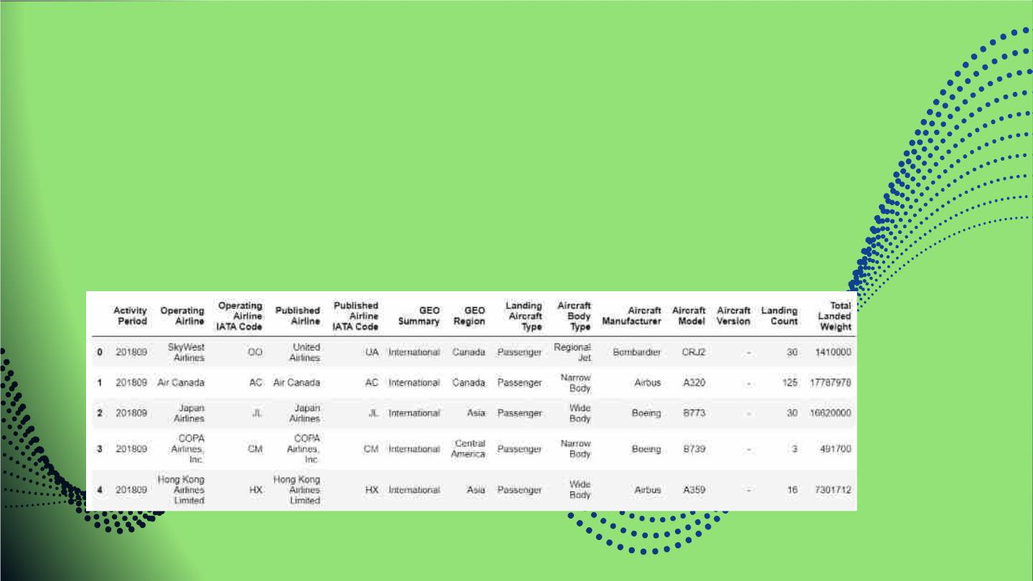
First step is reading raw data
Code:

Slide 8

Data
Preprocessing
& Cleaning
8

Slide 9
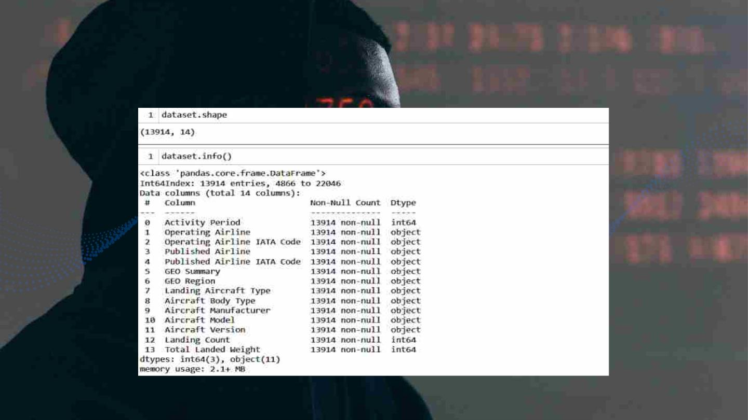
2. Data preprocessing and cleaning
9

Slide 10
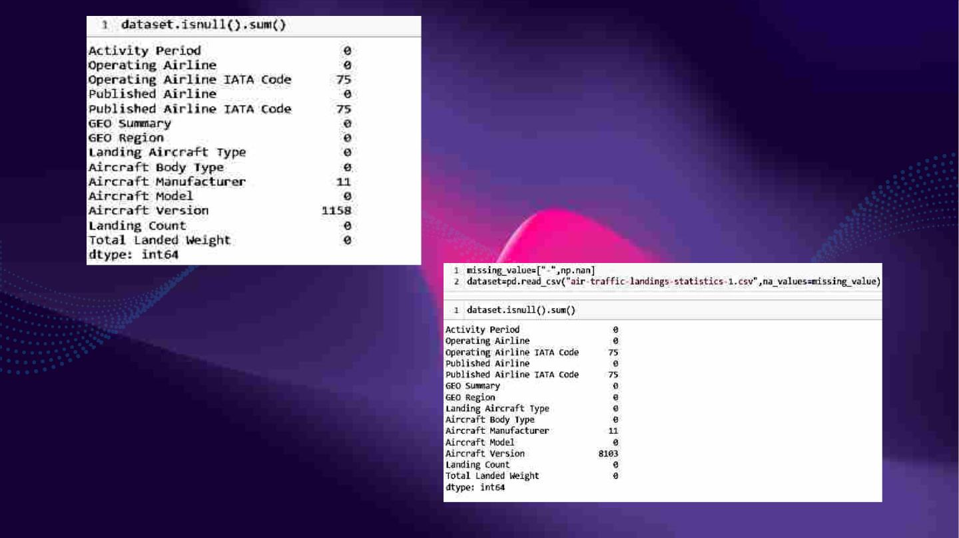
10

Slide 11
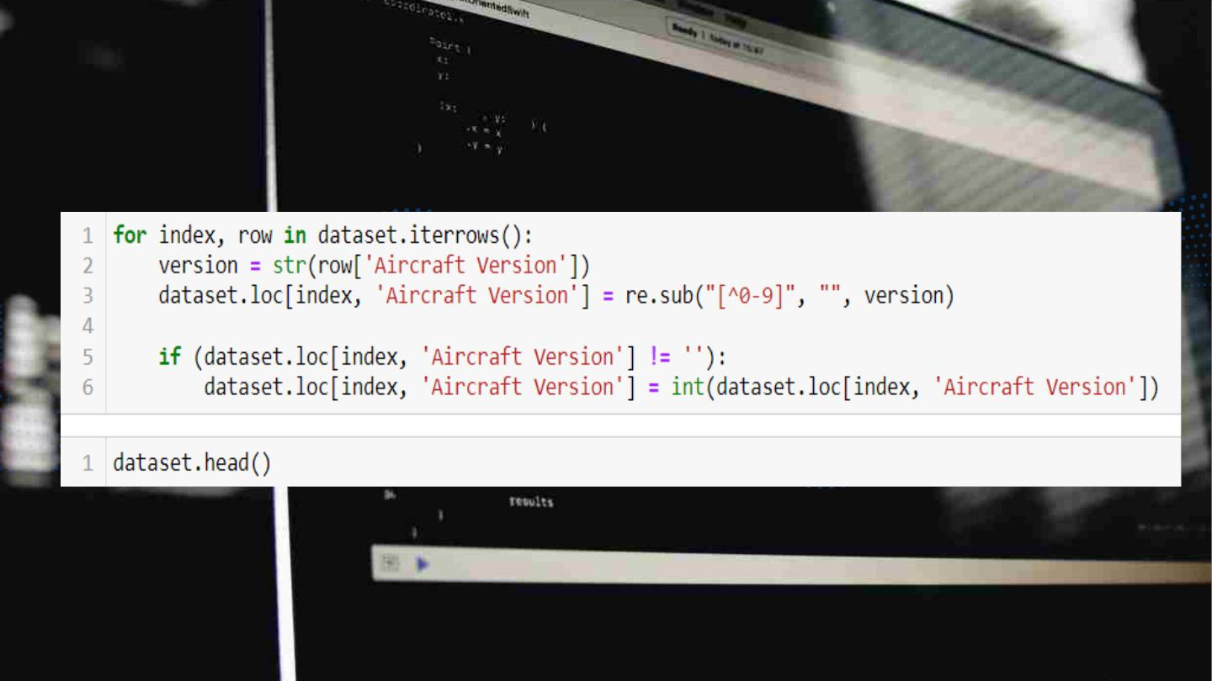
11

Slide 12
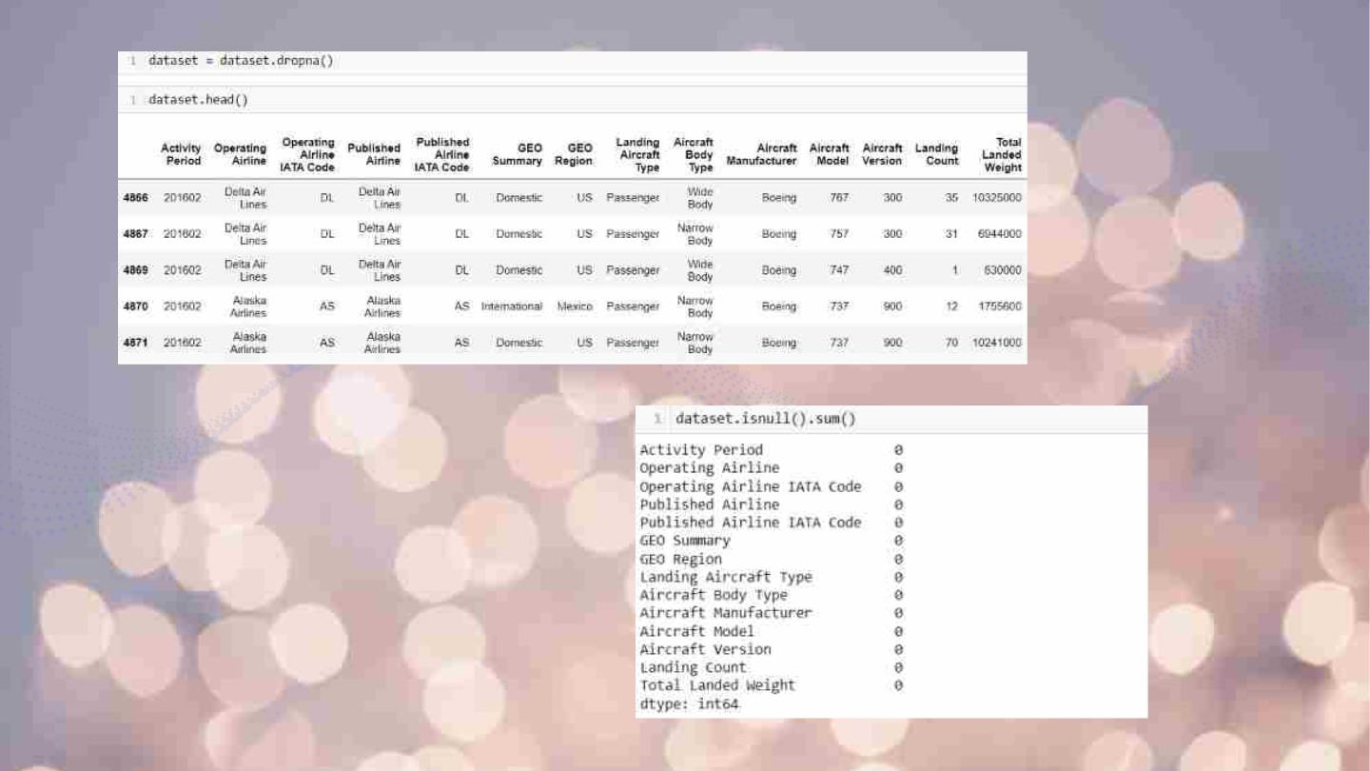
12

Slide 13

Data
Visualization
13

Slide 14

3. Data visualization
14

Slide 15
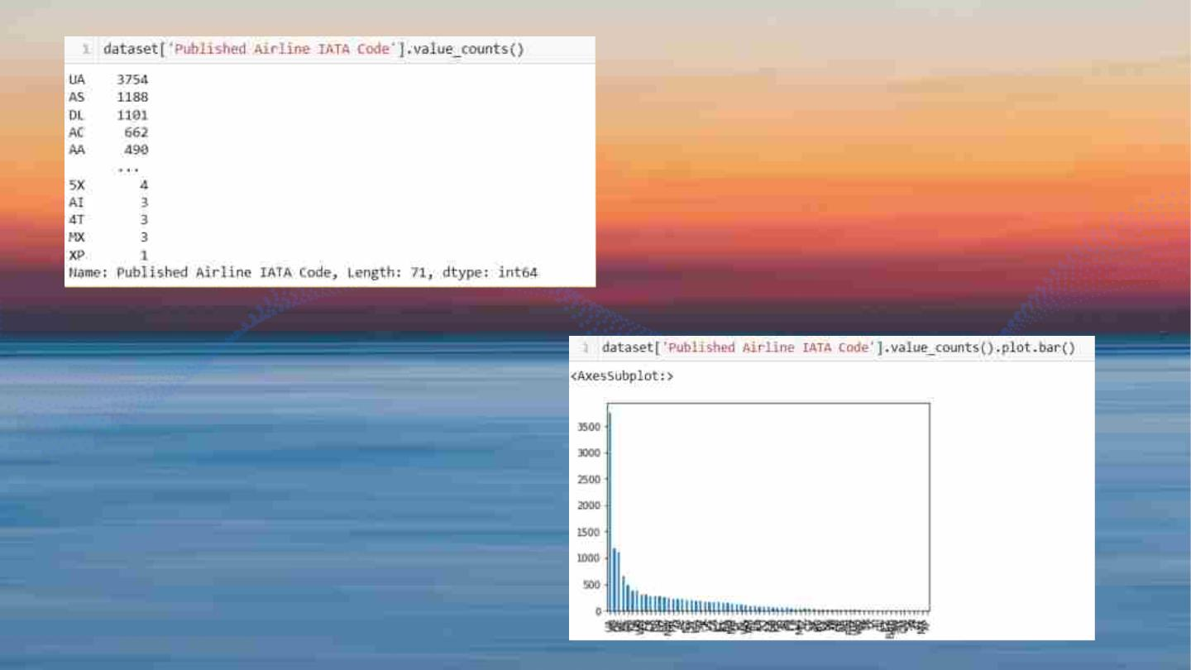
15

Slide 16
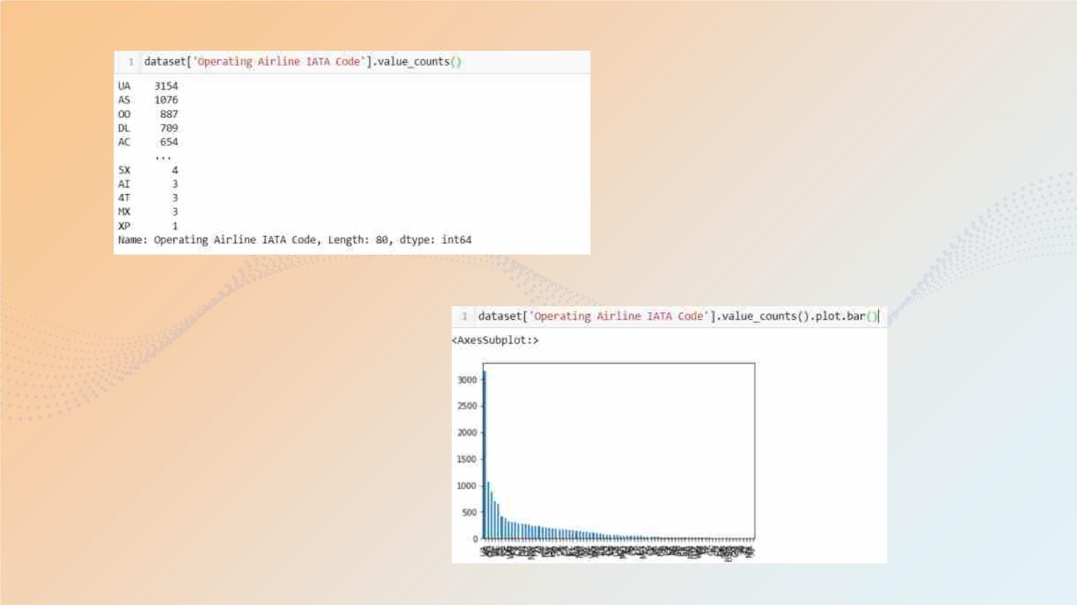
16

Slide 17
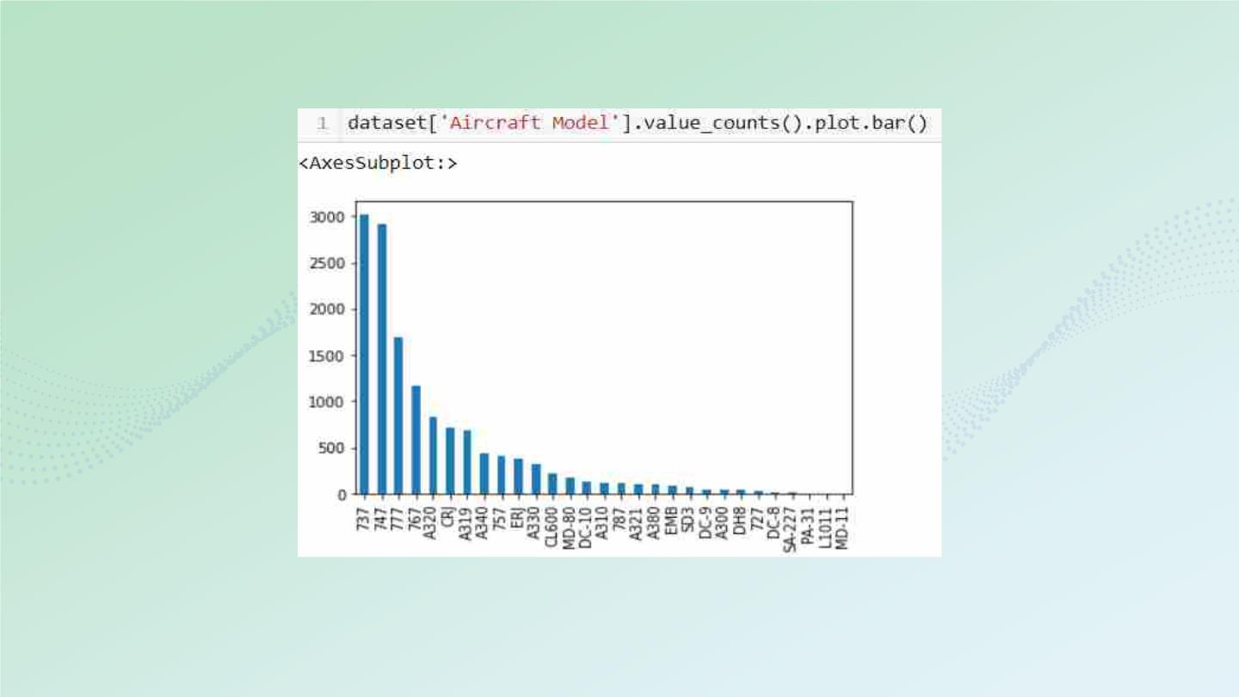
17

Slide 18
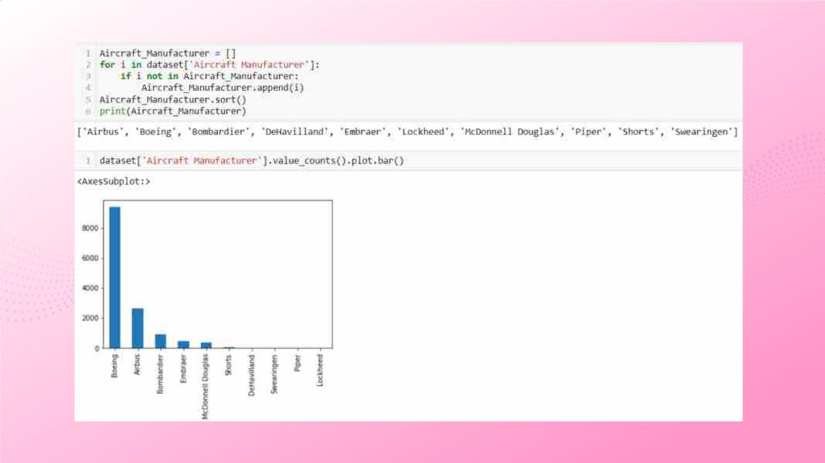
18

Slide 19
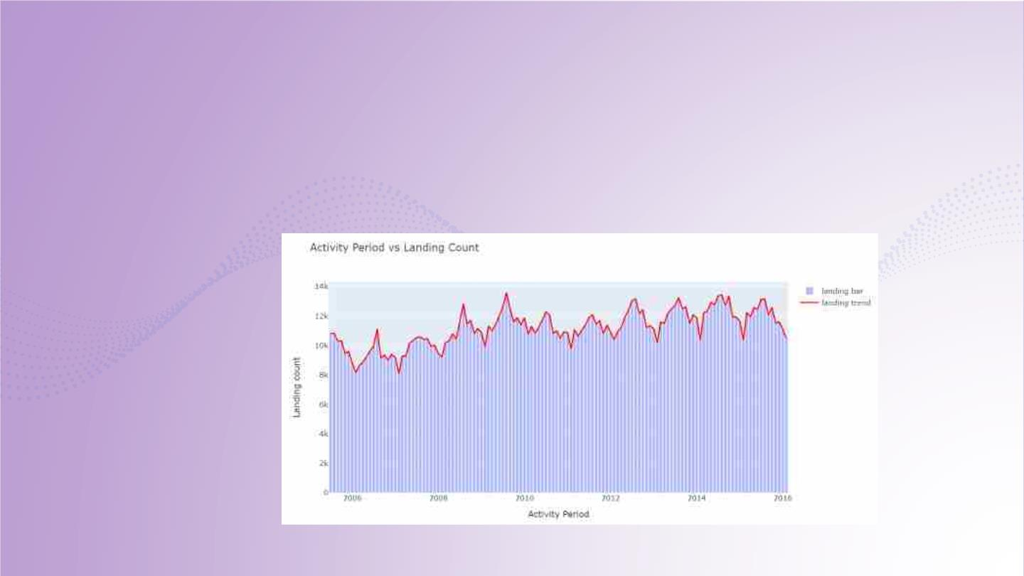
plot = dataset.groupby('Activity Period')['Landing Count'].sum()
fig = go.Figure()
fig.add_trace(go.Bar(x=plot.index, y=plot.values, name='landing
bar',opacity=0.9,marker_color='#a5afff'))
fig.add_trace(go.Scatter(x=plot.index, y=plot.values, line=dict(color='red'),
name='landing trend'))
fig.update_layout(
title="Activity Period vs Landing Count",
xaxis_title="Activity Period",
yaxis_title="Landing count",
)
fig.show()
19

Slide 20
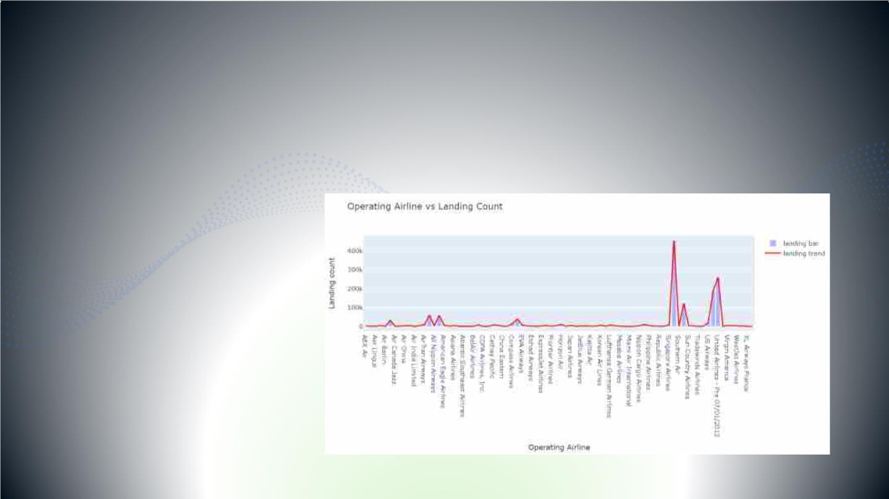
plot1 = dataset.groupby('Operating Airline')['Landing Count'].sum()
fig = go.Figure()
fig.add_trace(go.Bar(x=plot1.index, y=plot1.values, name='landing
bar',opacity=0.9,marker_color='#a5afff'))
fig.add_trace(go.Scatter(x=plot1.index, y=plot1.values, line=dict(color='red'),
name='landing trend'))
fig.update_layout(
title="Operating Airline vs Landing Count",
xaxis_title="Operating Airline",
yaxis_title="Landing count",
)
fig.show()
20

Slide 21
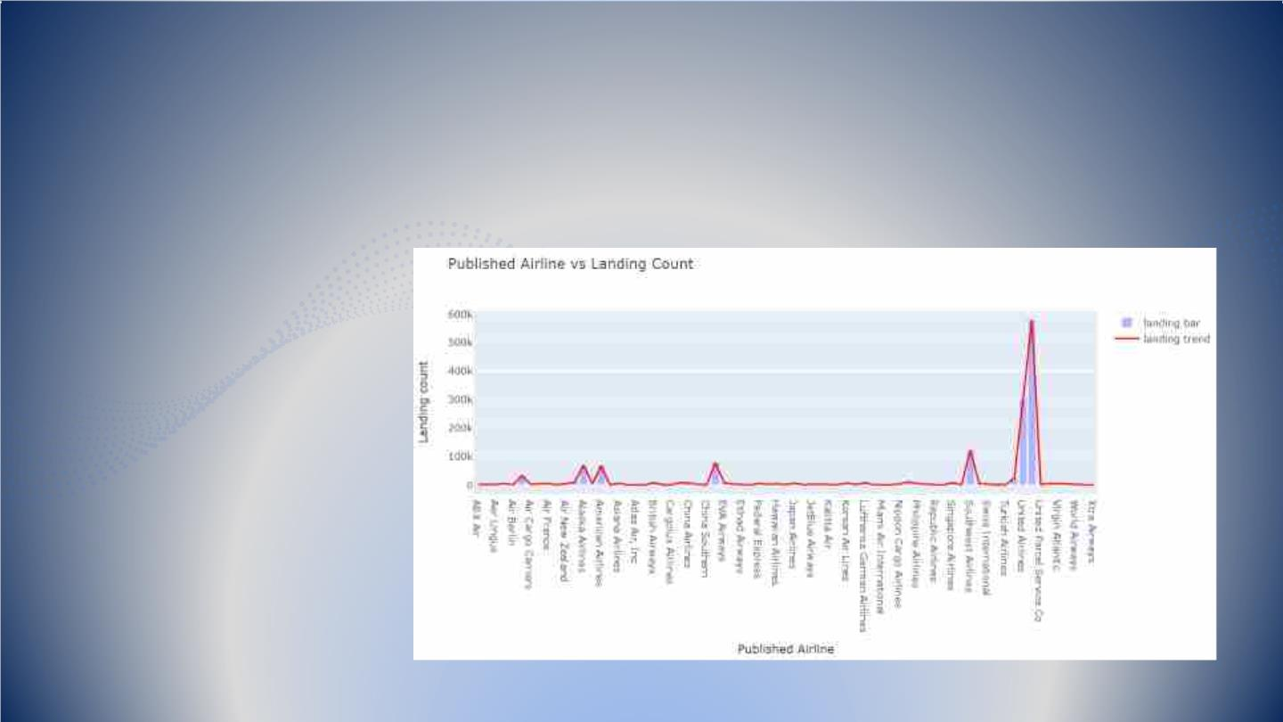
line",
ount",
21

Slide 22
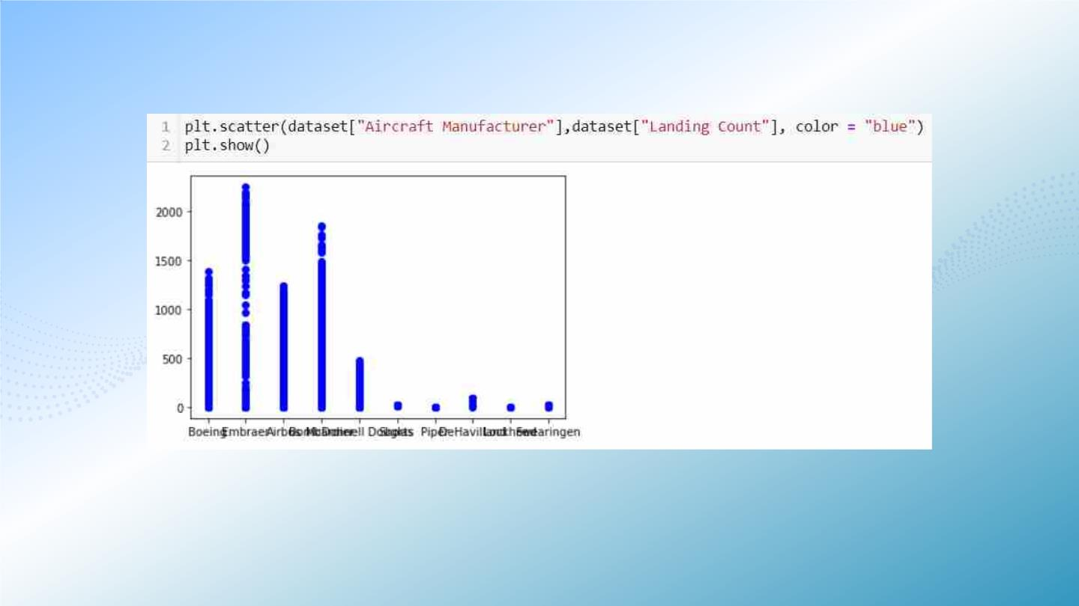
22

Slide 23
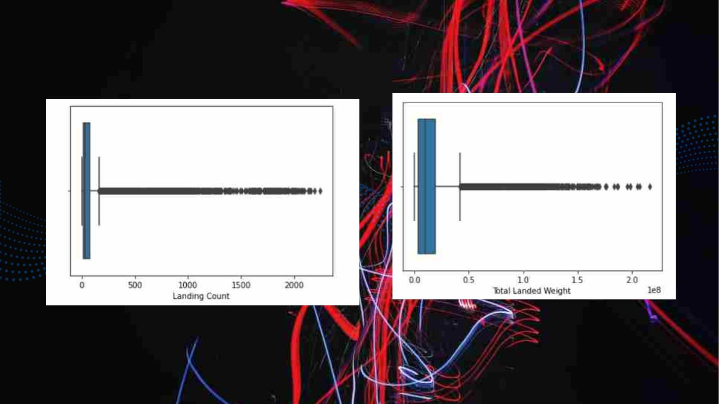
sns.boxplot(dataset['Landing Count'])
sns.boxplot(dataset['Total Landed Weight'])
23

Slide 24
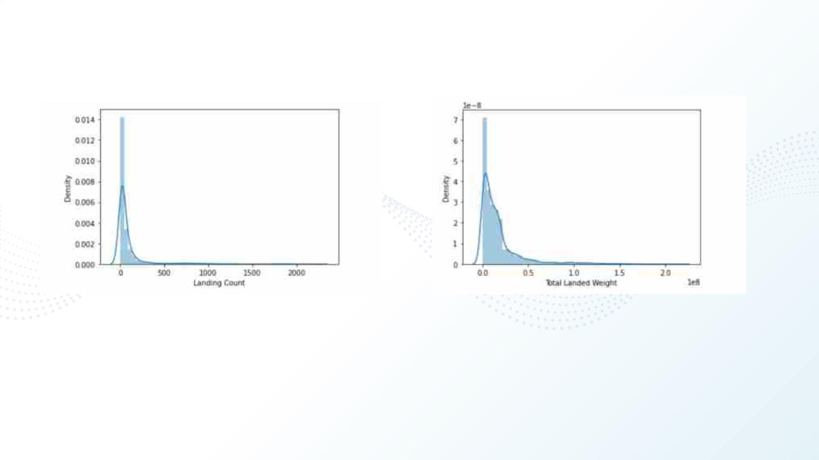
sns.distplot(dataset['Landing Count'])
sns.distplot(dataset['Total Landed Weight'])
24

Slide 25
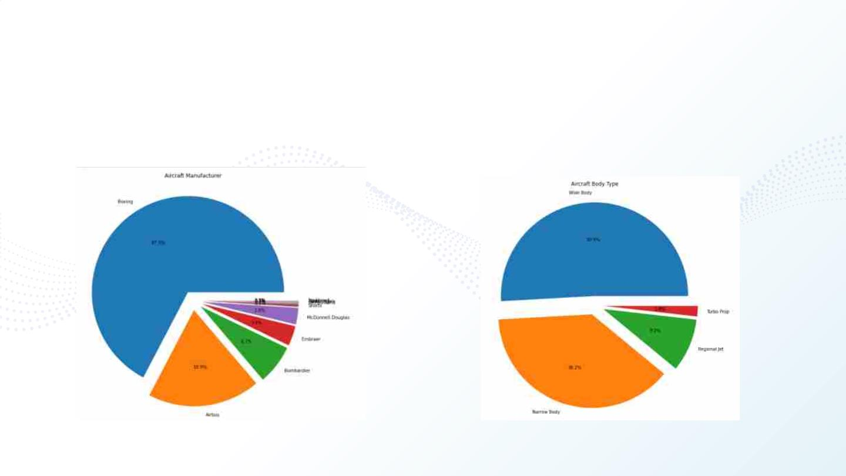
for i in ['Aircraft Manufacturer','Aircraft Body Type']:
A = dataset[i].value_counts().index.tolist()
Vals = list(pd.value_counts(PAX[i]))
explode = [0.1]*len(A)
plt.figure(figsize=(10,10))
plt.title(i)
plt.pie(Vals,explode=explode,labels=A,autopct='%.1f%%')
plt.show()
25

Slide 26
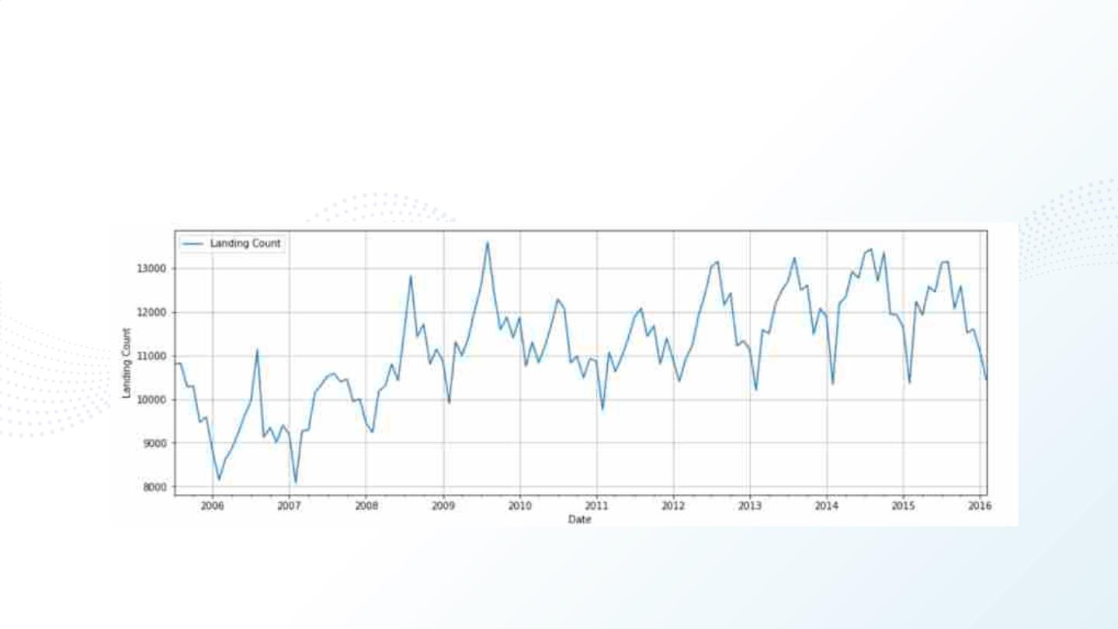
TS1 = dataset.groupby("Activity Period")["Landing Count"].sum().to_frame()
f, ax1 = plt.subplots(1,1,figsize=(15,5))
TS1.plot(ax=ax1)
ax1.set_xlabel("Date")
ax1.set_ylabel("Landing Count")
plt.grid(True)
26

Slide 27
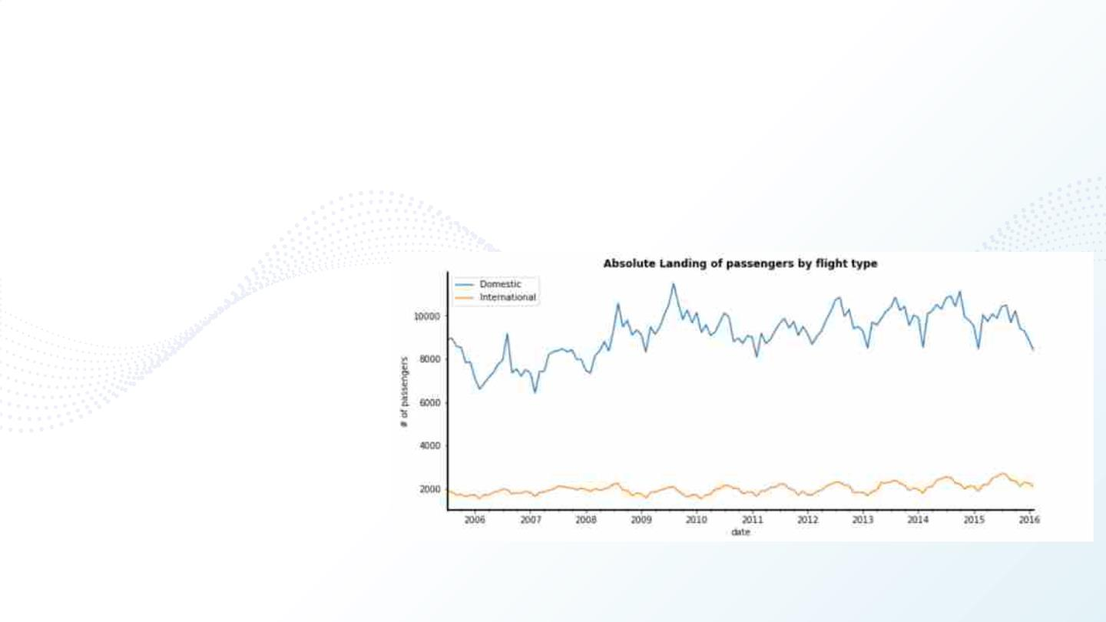
TS2 = dataset[dataset["GEO Summary"]=="Domestic"].groupby("Activity
Period")["Landing Count"].sum()
TS3 = dataset[dataset["GEO Summary"]=="International"].groupby("Activity
Period")["Landing Count"].sum()
TS = pd.concat([TS2,TS3],axis=1)
TS.columns=["Domestic","International"]
ax = TS.plot(figsize=(12,5))
ax.set_title("Absolute Landing of passengers by flight type", fontweight="bold")
ax.set_xlabel('date')
ax.set_ylabel('# of passengers')
for loc in ['bottom', 'left']:
ax.spines[loc].set_visible(True)
ax.spines[loc].set_linewidth(2)
ax.spines[loc].set_color('black')
ax.spines['right'].set_visible(False)
ax.spines['top'].set_visible(False)
plt.show()
27

Slide 28
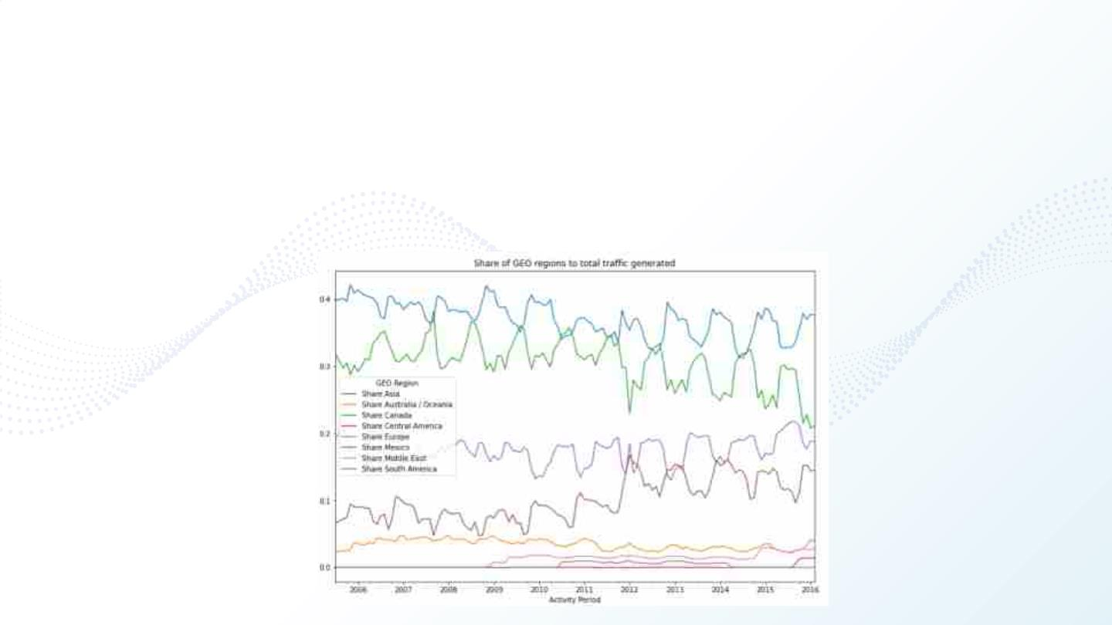
TS4 = dataset.groupby(["Activity Period","GEO Region"])["Landing Count"].sum()
TS4 = TS4.reset_index()
pivot = TS4.pivot_table(values="Landing Count",index="Activity Period",columns="GEO Region", fill_value=0)
pivot = pivot.drop("US",axis=1)
pivot["Total"] = pivot.sum(axis=1)
for col in pivot.columns[:-1]:
pivot["Share " + str(col)]=pivot[col]/pivot["Total"]
ratios = pivot.iloc[:,-8:]
ratios.plot(figsize=(12,8), title="Share of GEO regions to total traffic generated")
plt.show()
28

Slide 29

4.Data
Statistics
29

Slide 30
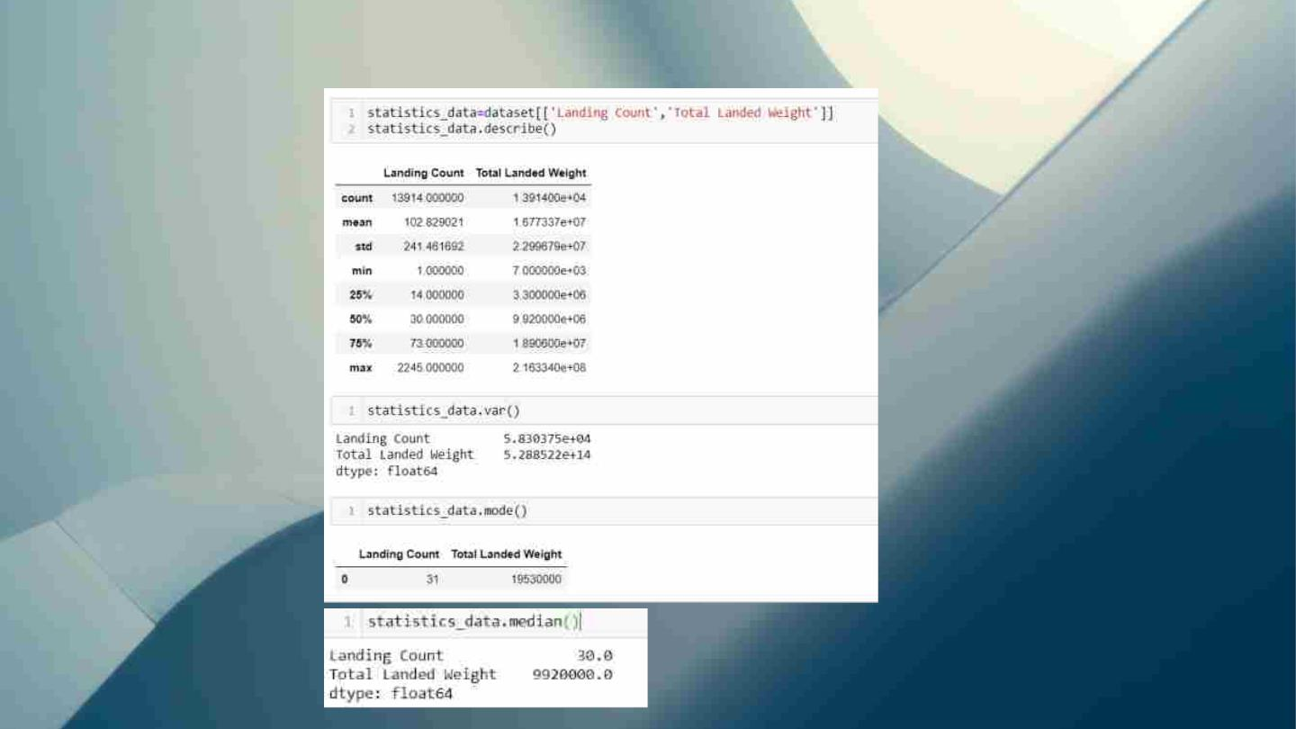
4. Data statistics
30

Slide 31
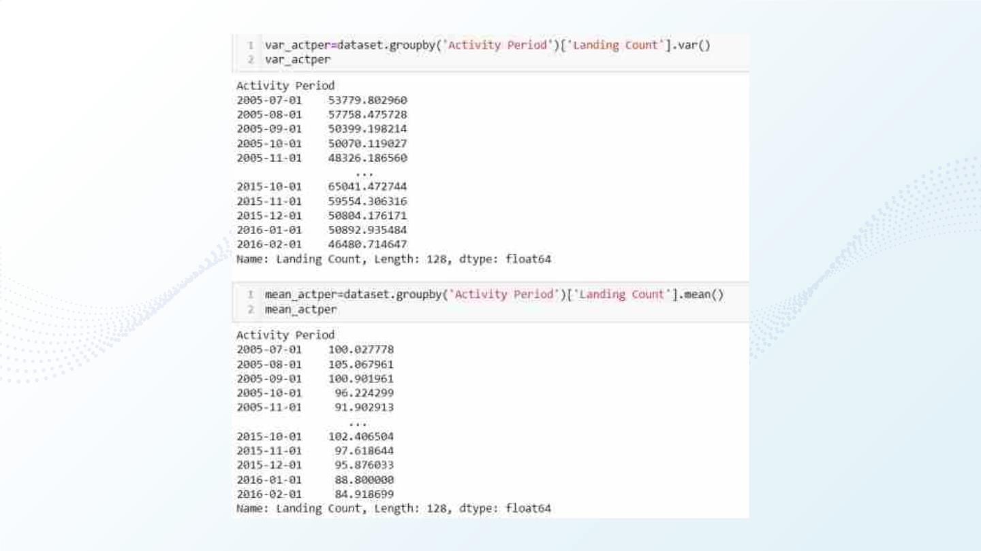
31

Slide 32
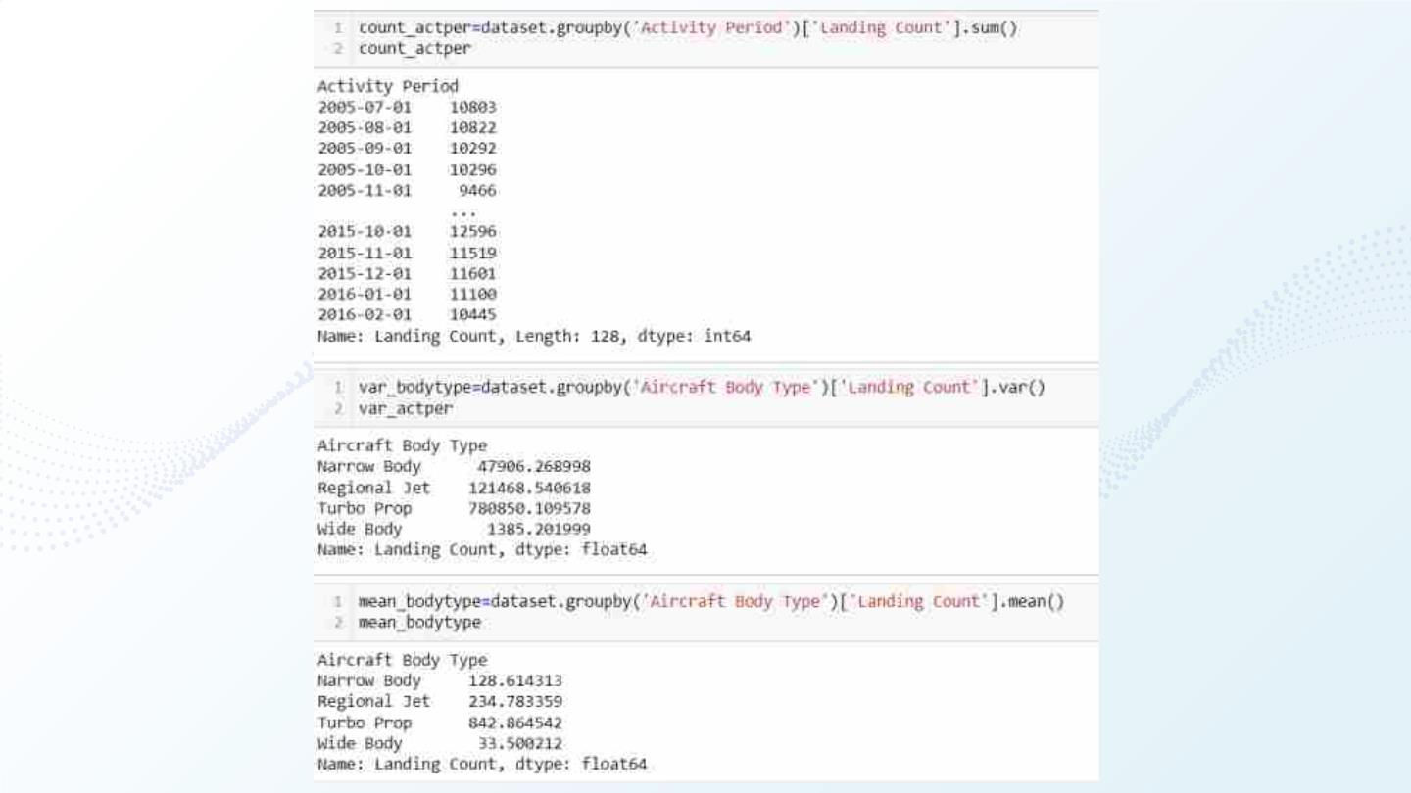
32

Slide 33

Hypothesis
Testing
33

Slide 34
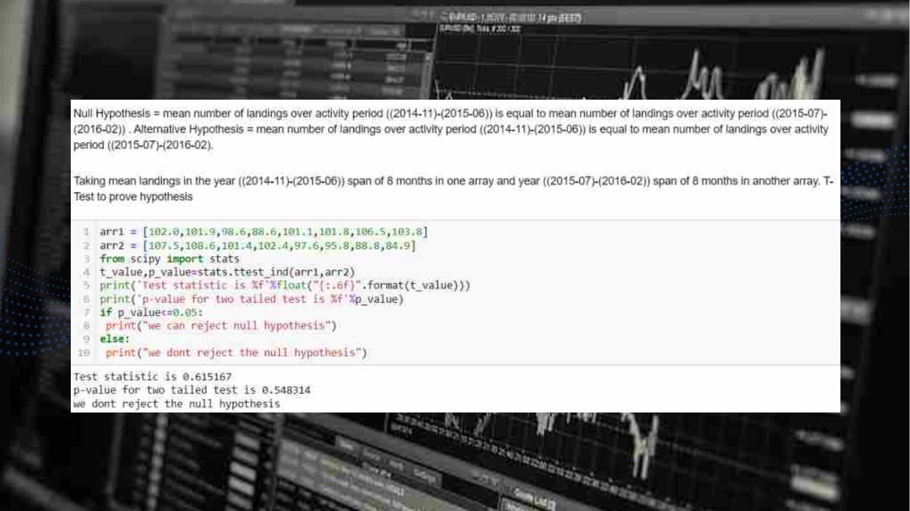
5. HYPOTHESIS TESTING
34

Slide 35

Data
Prediction
[using Machine learning model...]
35

Slide 36
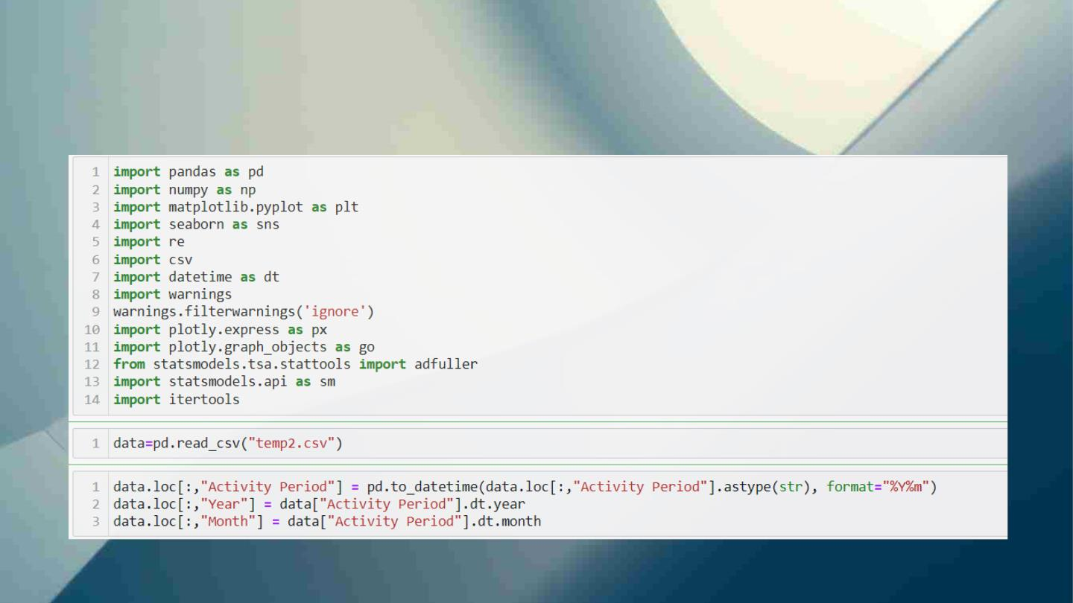
Importing CSV file and converting Activity period
column into year and month...
36

Slide 37
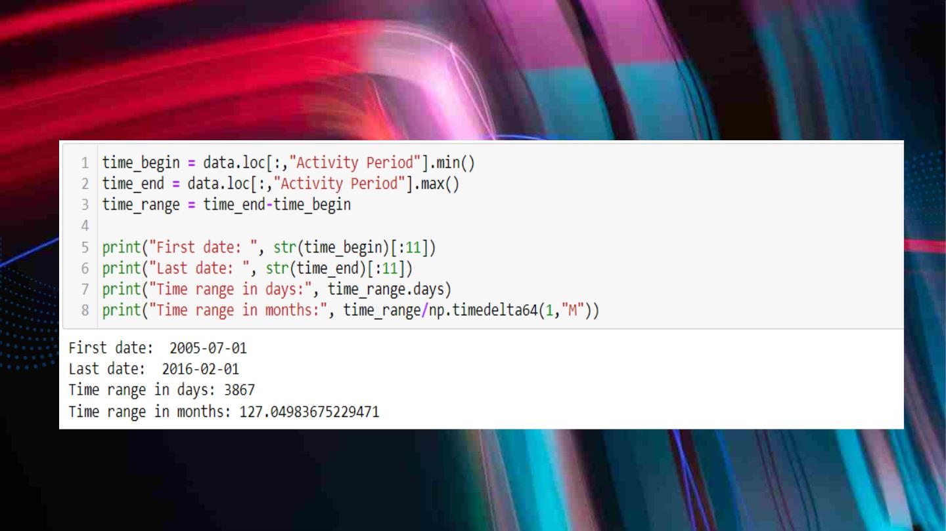
Printing starting and ending date
37

Slide 38
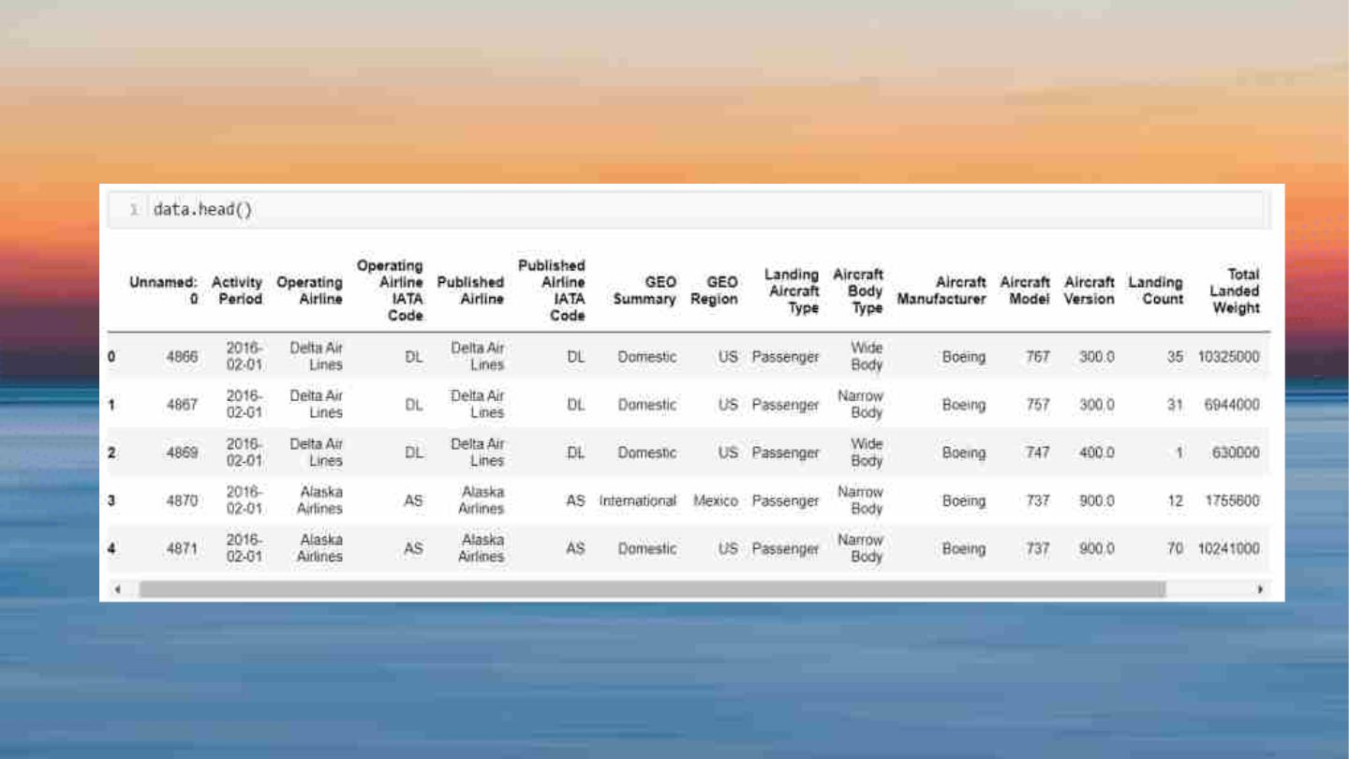
Viewing preview
38

Slide 39
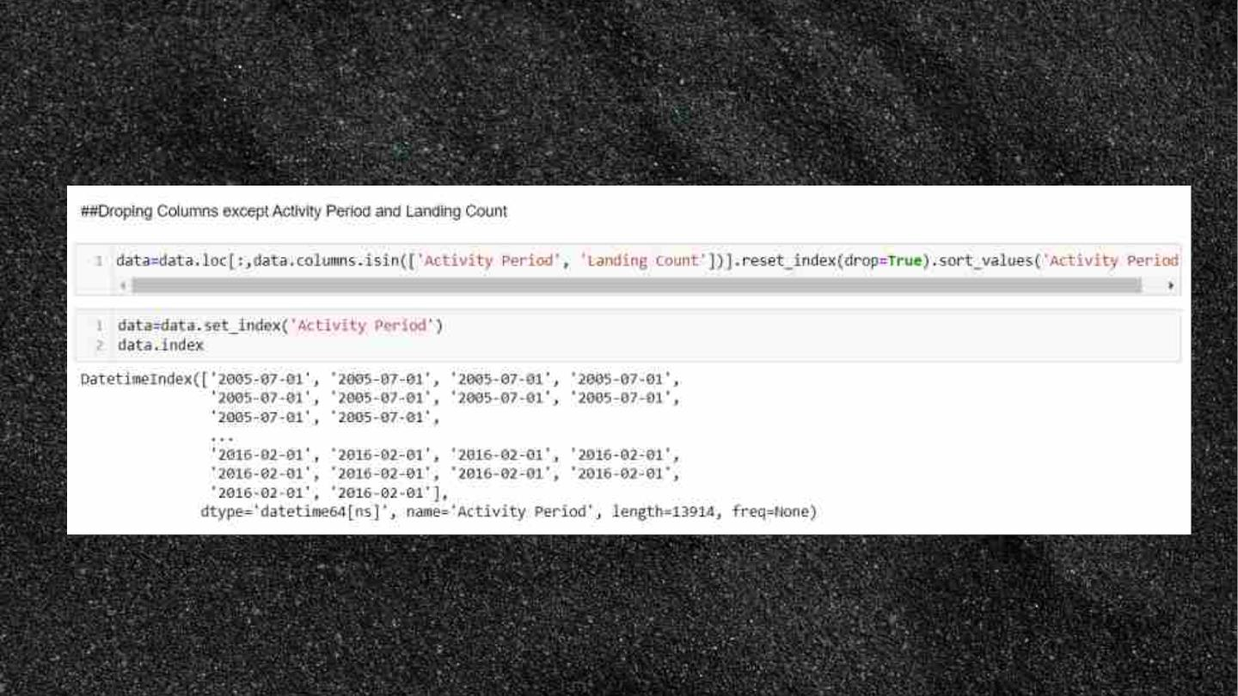
Taking only required columns for data prediction
39

Slide 40
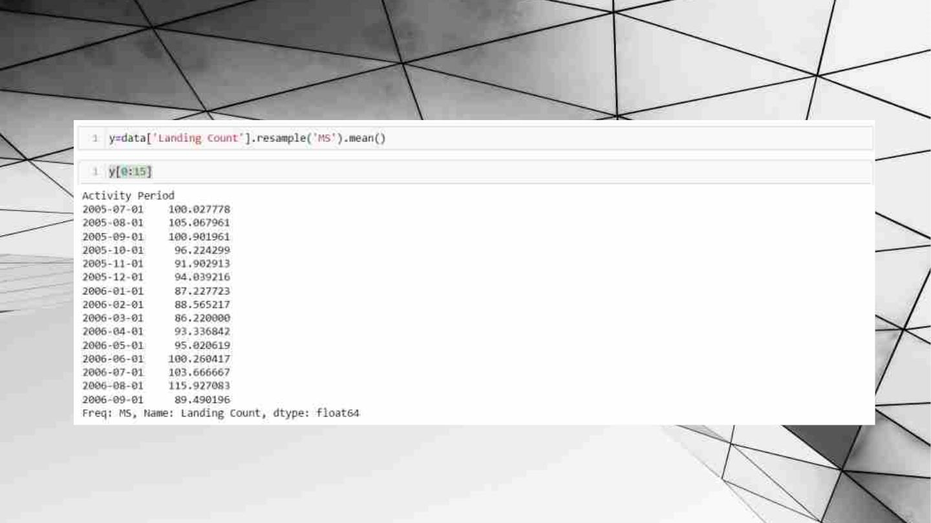
Grouping over months and finding mean landings
40

Slide 41

Grouping over months and finding mean
landings..
41

Slide 42
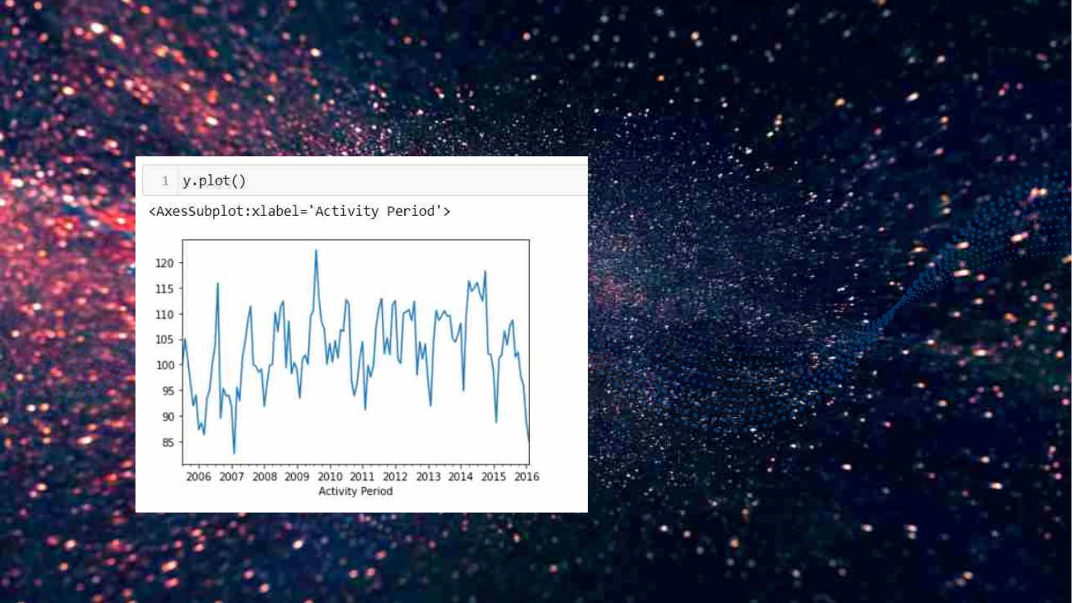
Overview of the landing count vs activity period
42

Slide 43
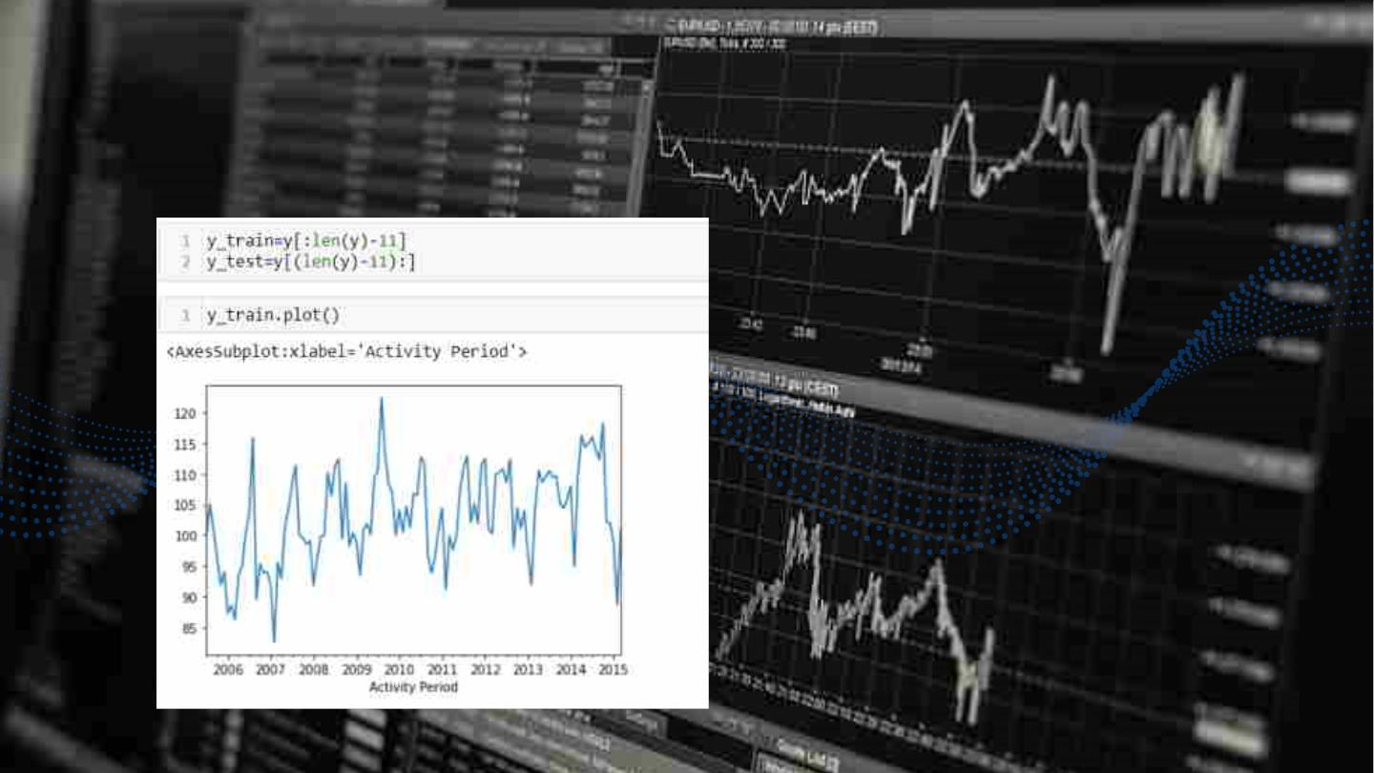
Slicing data such that training data is for model
preparation and test data for model verification
Plot of train data
43

Slide 44
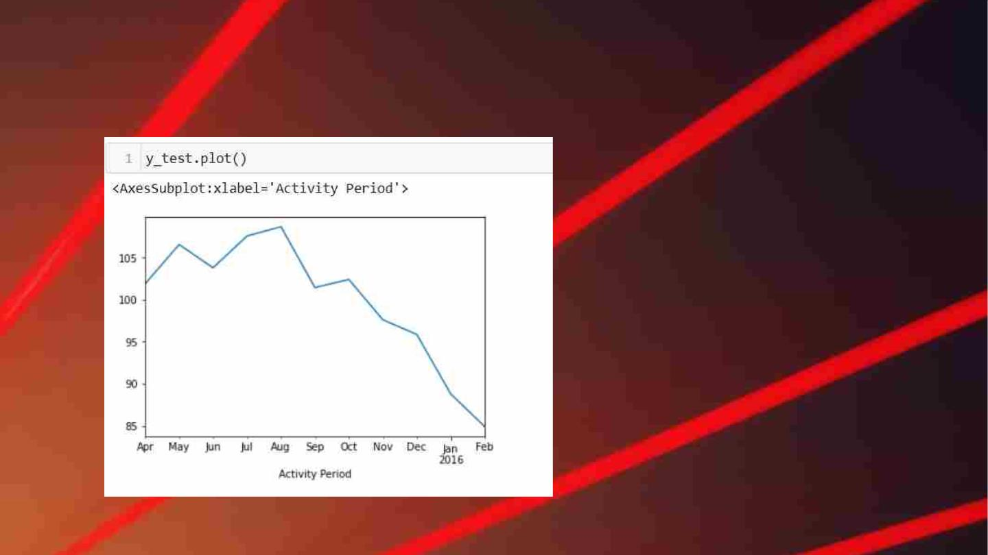
Plot of test data
44

Slide 45
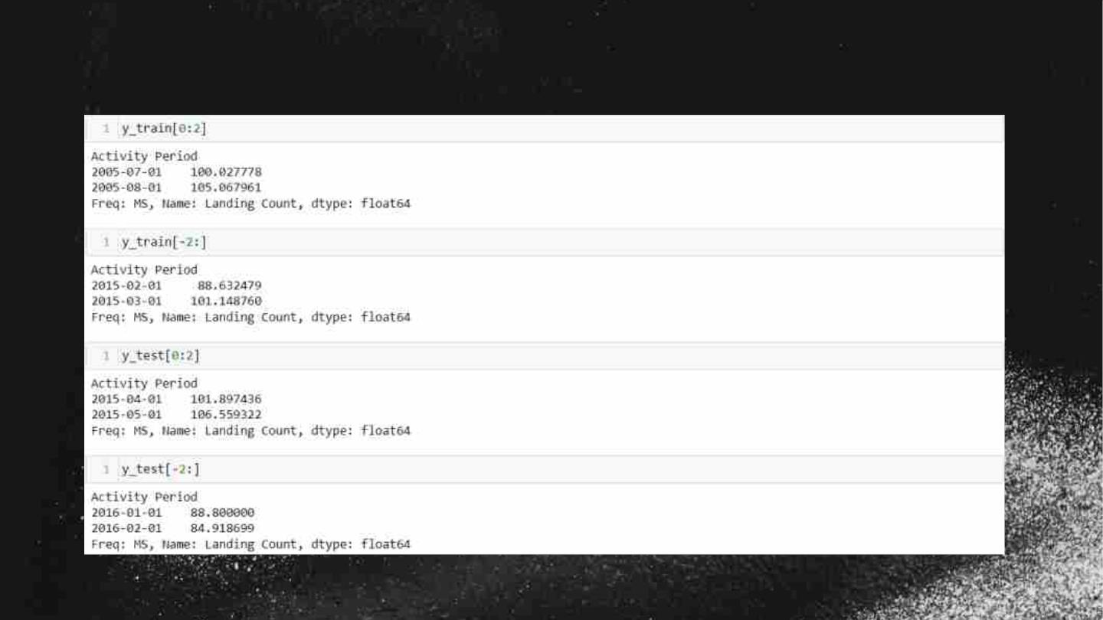
Overview of the slicing
45

Slide 46
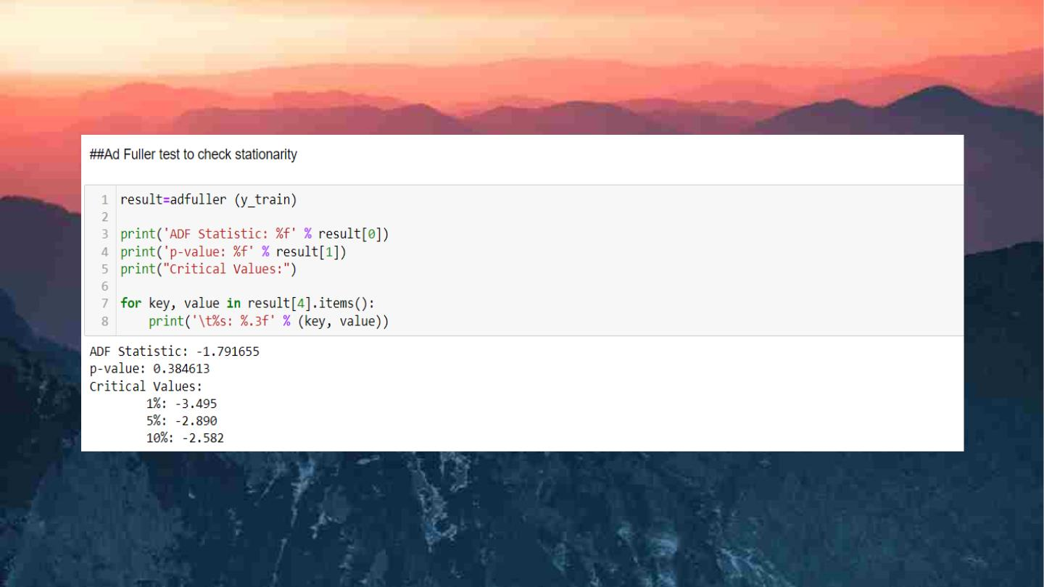
46

Slide 47
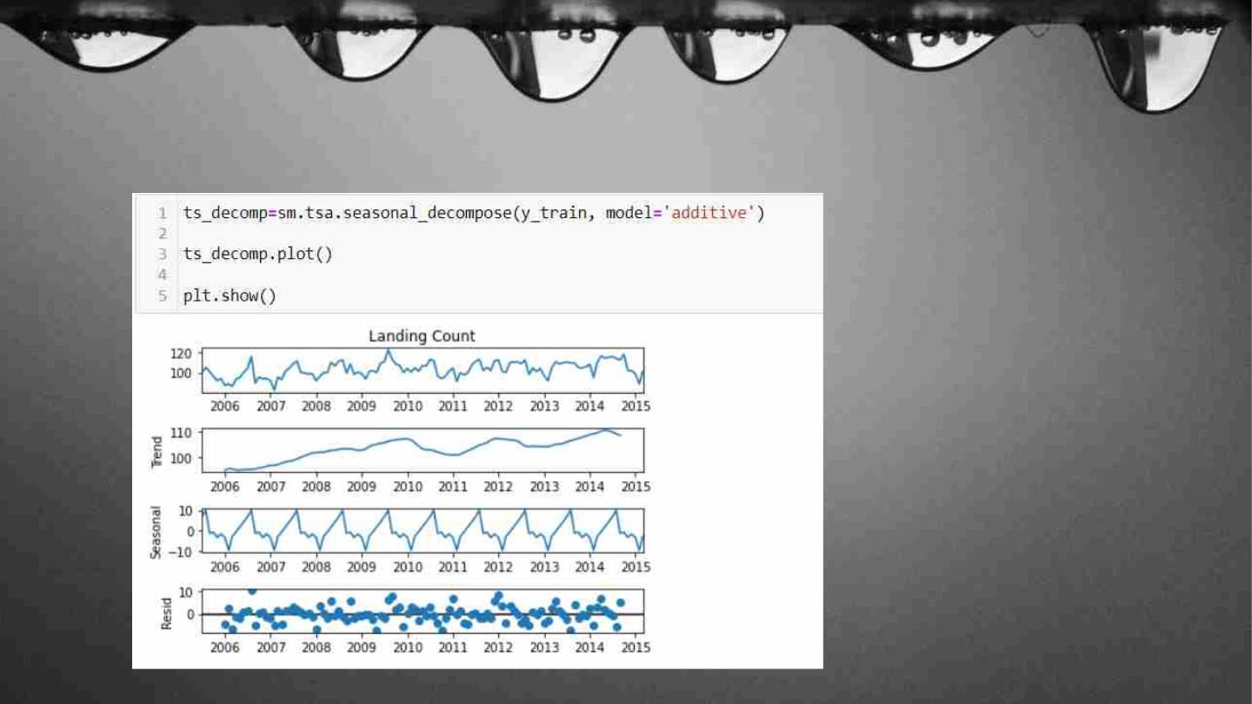
To better understand the time series behavior I will decompose it
into trend, seasonality, and residuals.
47

Slide 48
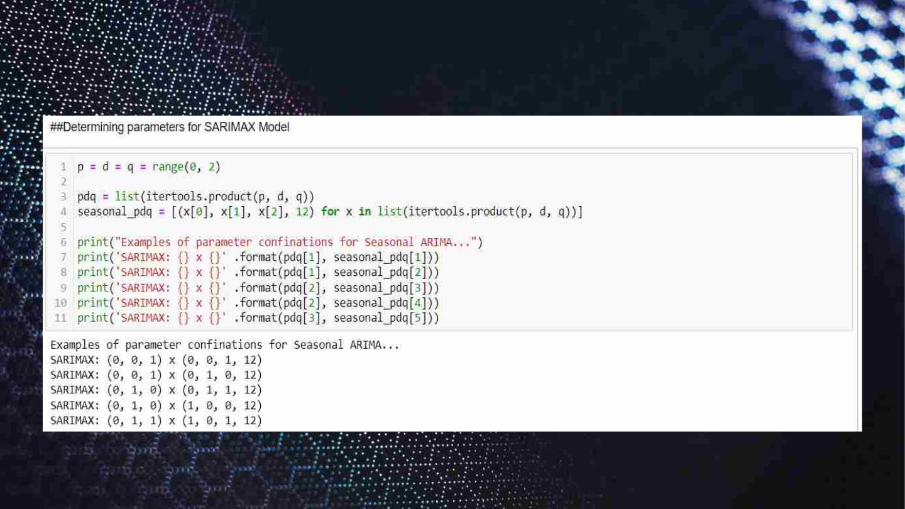
48

Slide 49
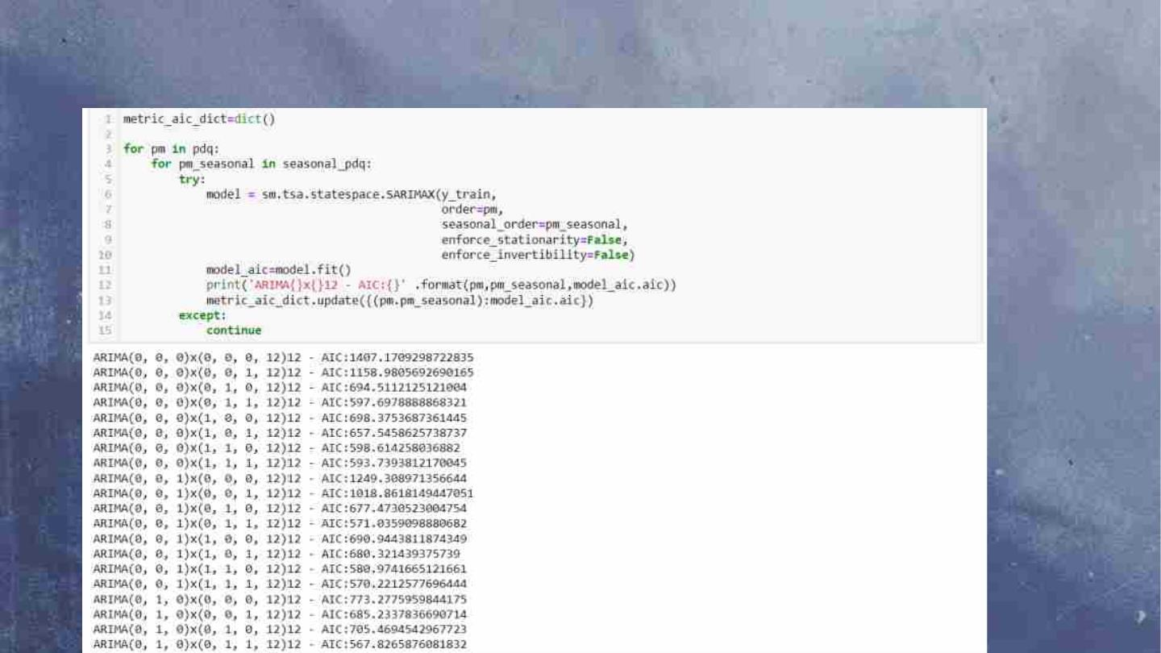
Looping for 3 parameters for ARIMA and next 4
parameters for seasonal component
49

Slide 50

50

Slide 51
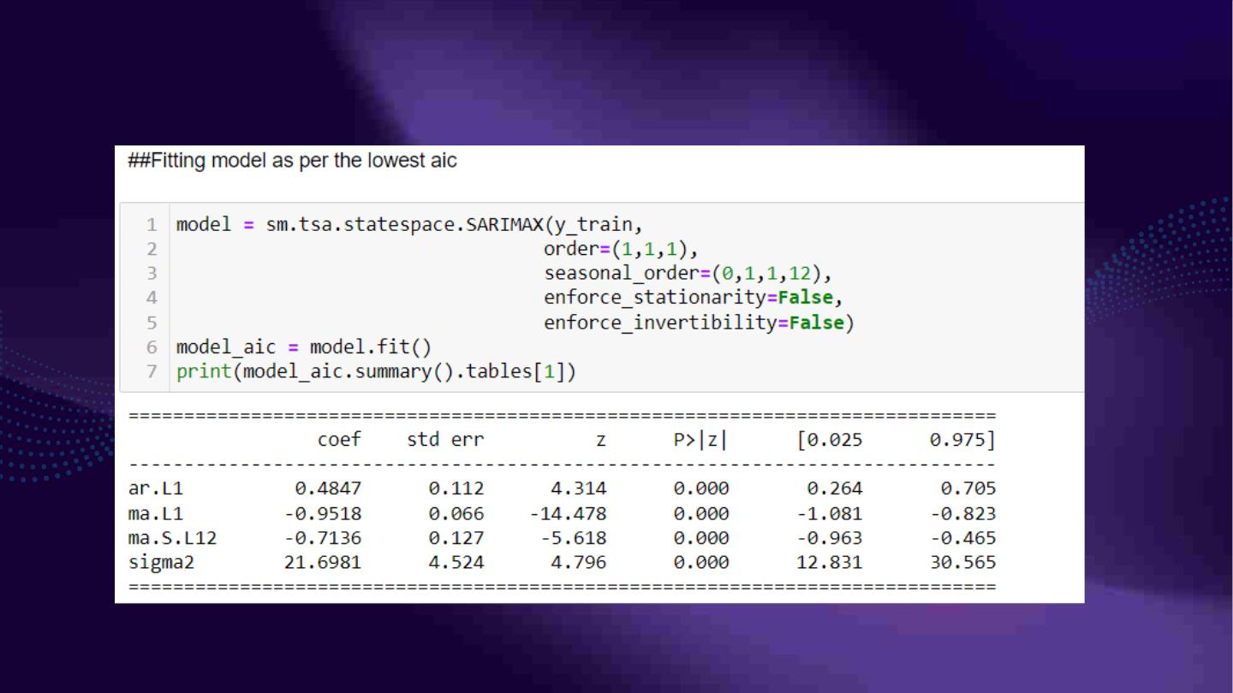
Model Results
51

Slide 52
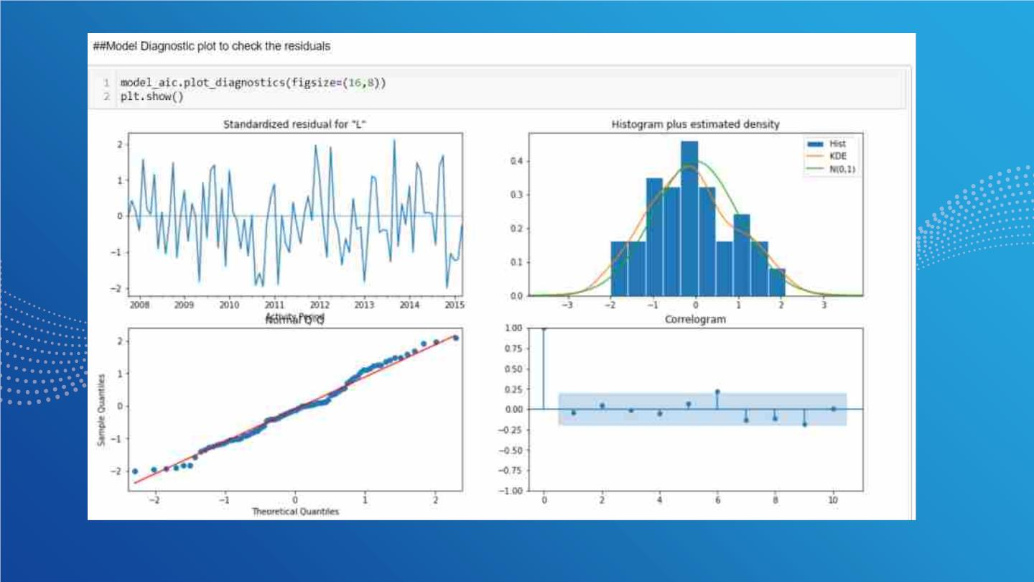

Slide 53
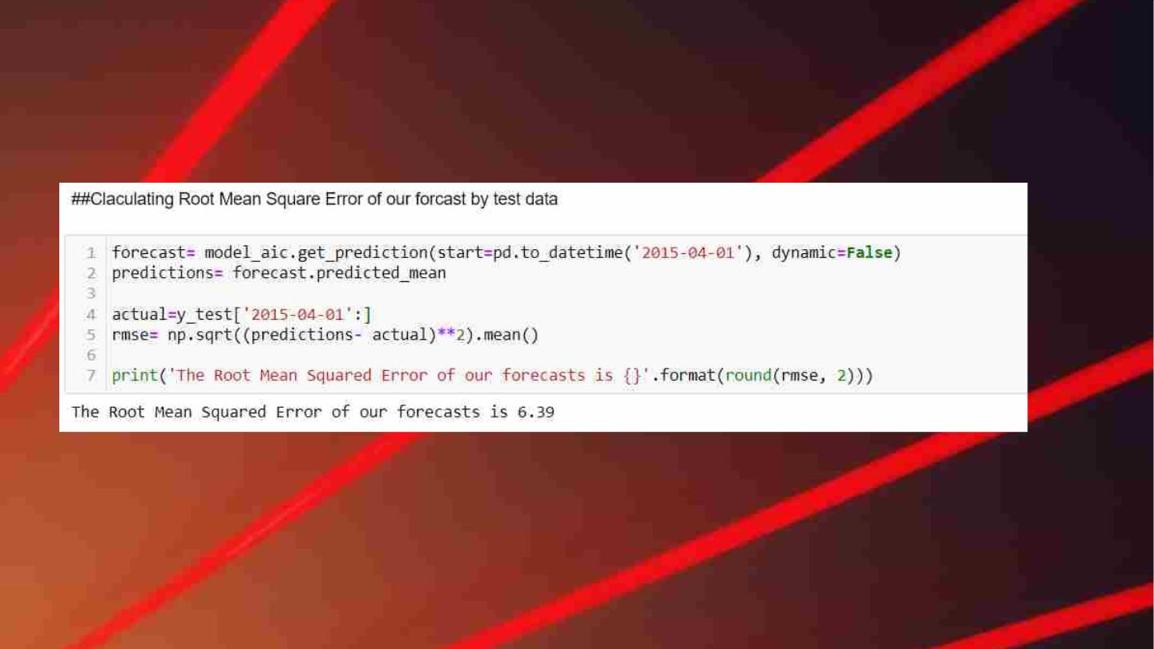
53

Slide 54
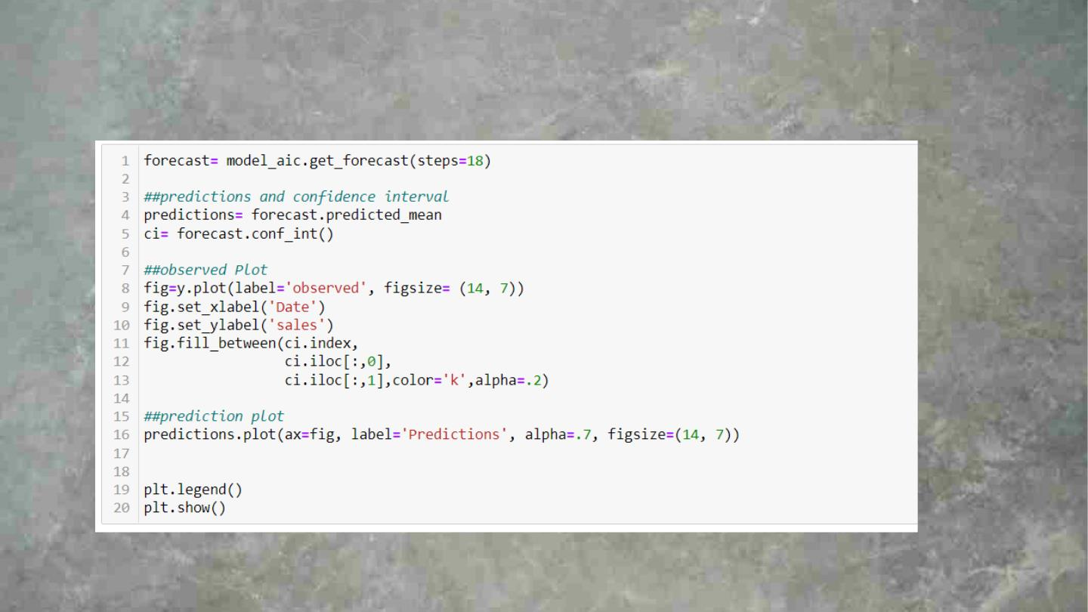
Plot for test data and next 6 months from our model.
54

Slide 55
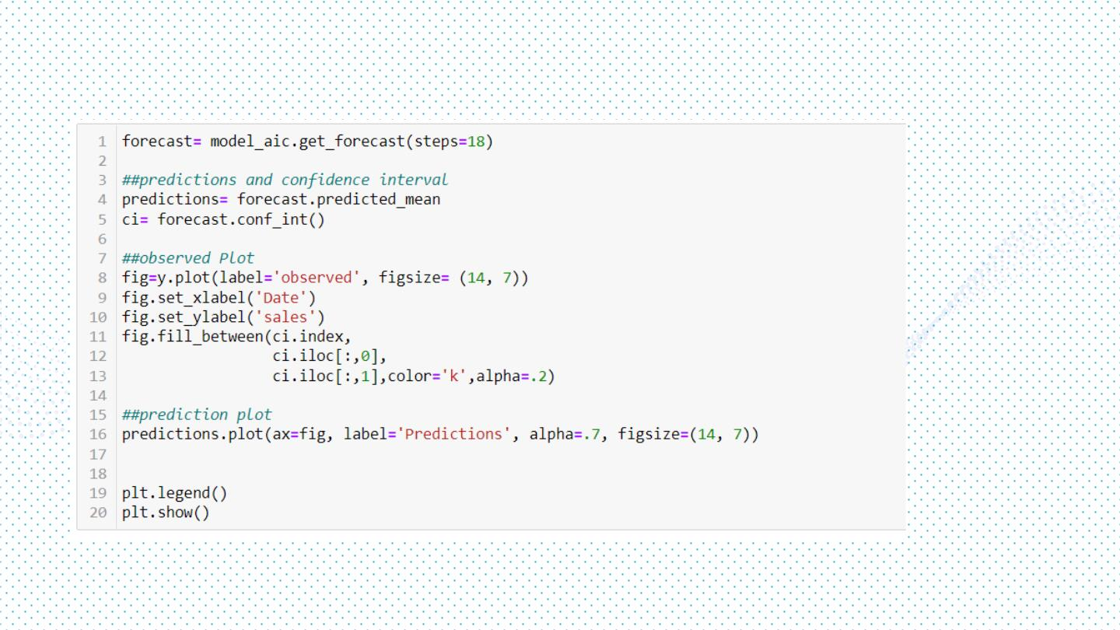
Plot for test data and next 6 months from our model
55

Slide 56
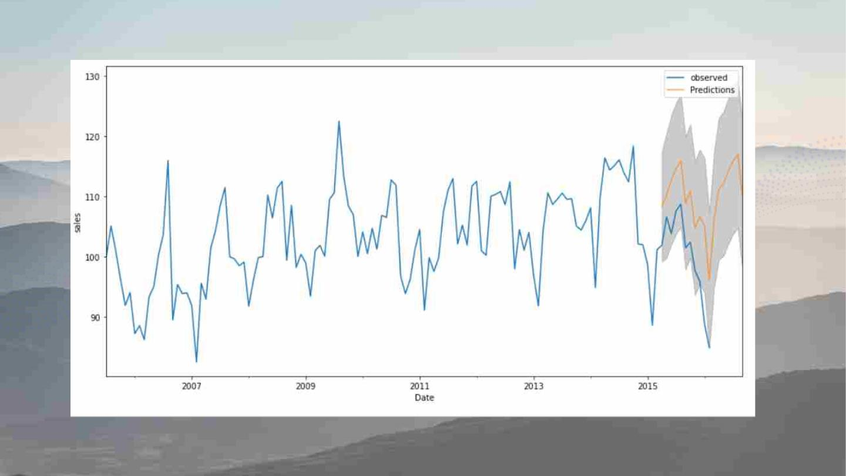
56

Slide 57

Airꢀport

Slide 58

58

Slide 59

The Team
Tarun Meruga
2001ME78
2001ME18
2001ME37
2001CB44
2001MM09
2001ME47
Chowke Rohan.
Macherla Venkata Bhanu
Uday Kumar.
Cheekati Abhishek.
Pranav Raj
59

Slide 60

Thank you !!
For any queries please write at :
60

